Slide 1

Webinar on Raspberry pi

Slide 2
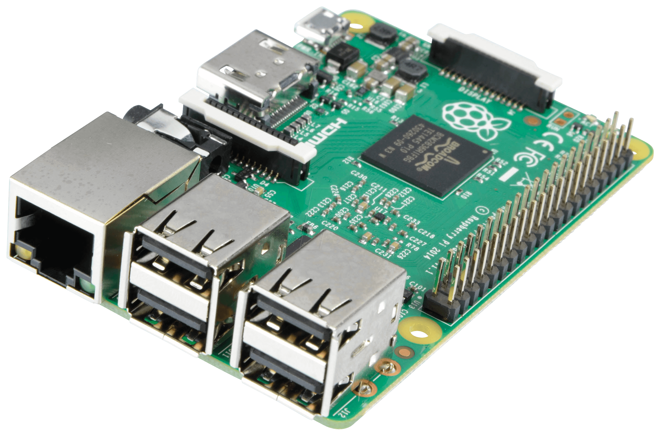
What is Raspberry-Pi ?
The Raspberry Pi is a low cost, credit-card sized computer that plugs into a computer monitor or TV, and uses a standard keyboard and mouse.
The microprocessor is the heart of computer.
Nowadays many of real time products are work based on controllers.
Ex: AC’s, Washing machines, Robots …….

Slide 3
Why Raspberry-Pi ?
Affordable credit-card sized computer
Plugs into a computer monitor or TV
Uses standard keyboard and mouse
Can browse the internet and play HD video
Can also interact with the outside world!

Slide 4
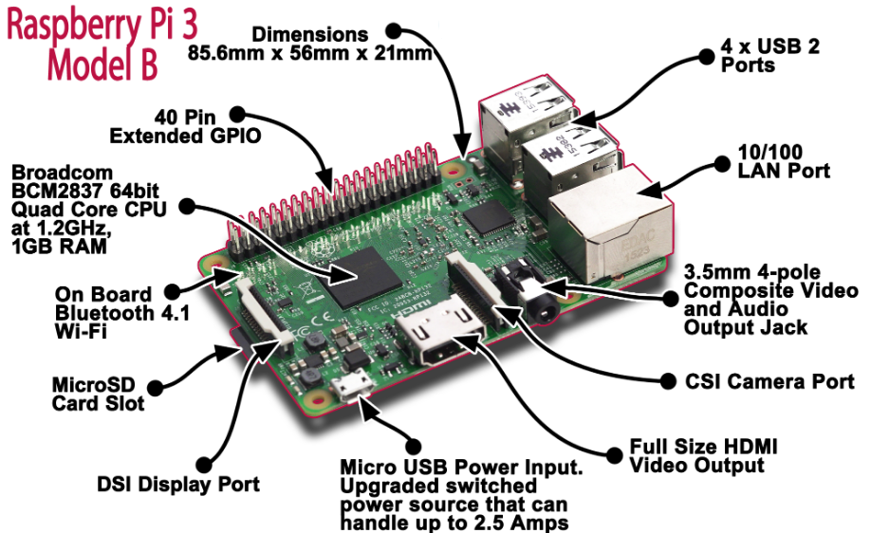

Slide 5
Features of Raspberry-Pi
Processor Chipset : Broadcom BCM2837 64Bit ARMv7 Quad Core Processor powered Single Board Computer running at 1250MHz
GPU : Videocore IV
Processor Speed : QUAD Core @1250 MHz
RAM : 1GB SDRAM @ 400 MHz
Storage : MicroSD
USB 2.0 : 4x USB Ports
Power Draw / voltage : 2 to2.5A @ 5V
GPIO : 40 pin
Ethernet Port : Yes
Wi-Fi : Built in
Bluetooth LE : Built in

Slide 6
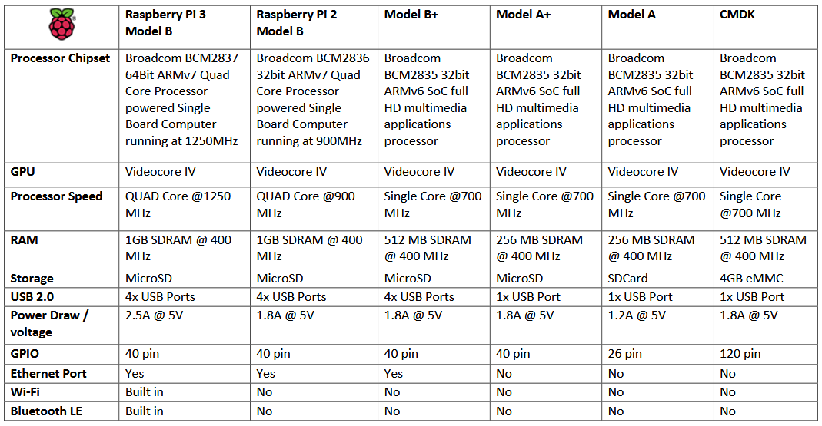

Slide 7
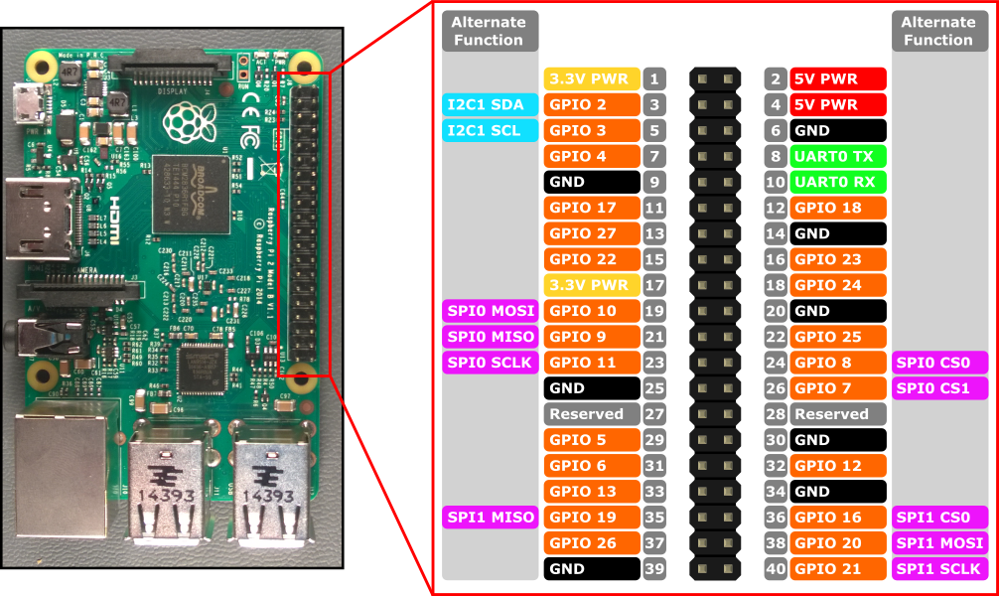
GPIO pins:

Slide 8
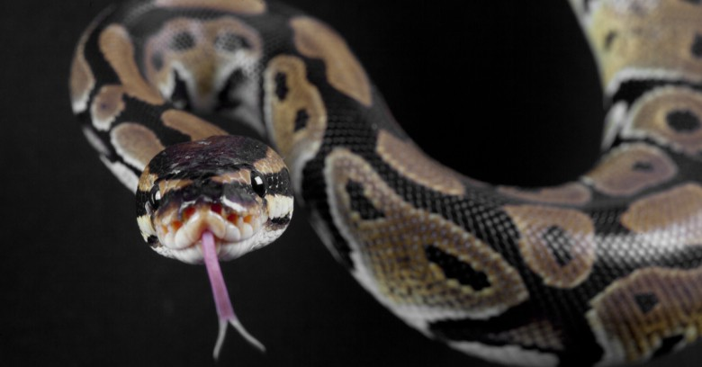

What is python?

Slide 9
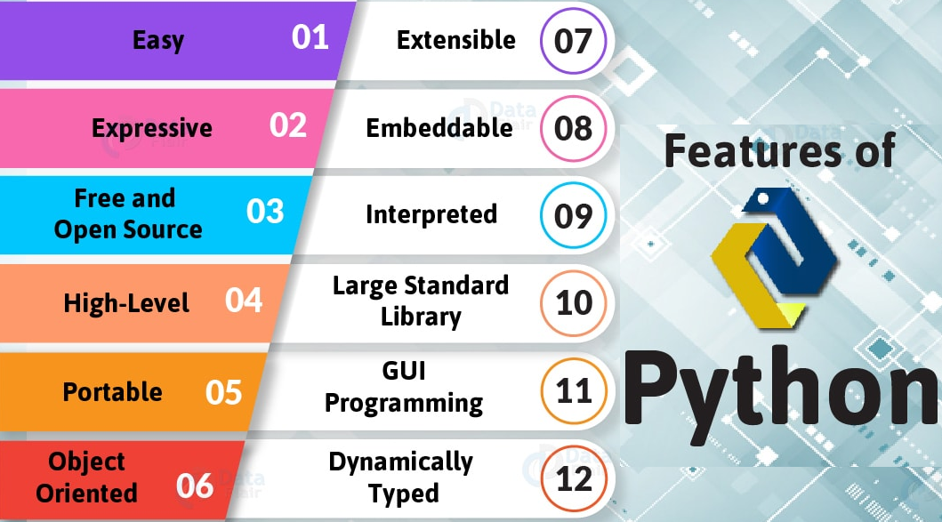
Features of python

Slide 10
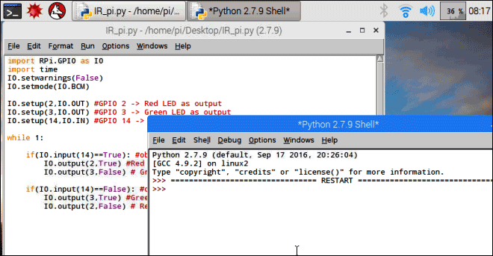
Python IDE

Slide 11
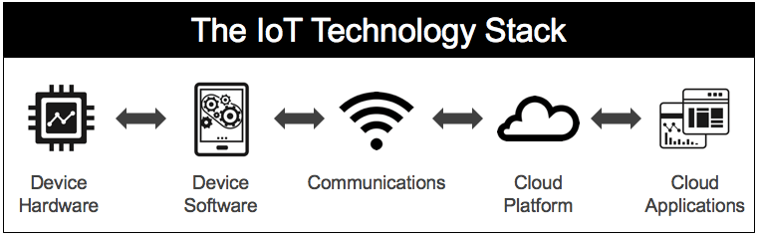
Introduction to IOT

Slide 12
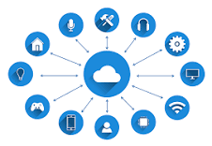
What is IoT?
Basically, “Internet of Things” is simply, devices which are connected together over the Internet. Hence, this connectivity allows them to be online all the time to share data between them. Also, analyze and make automated and real-time decisions based on these data.

Slide 13
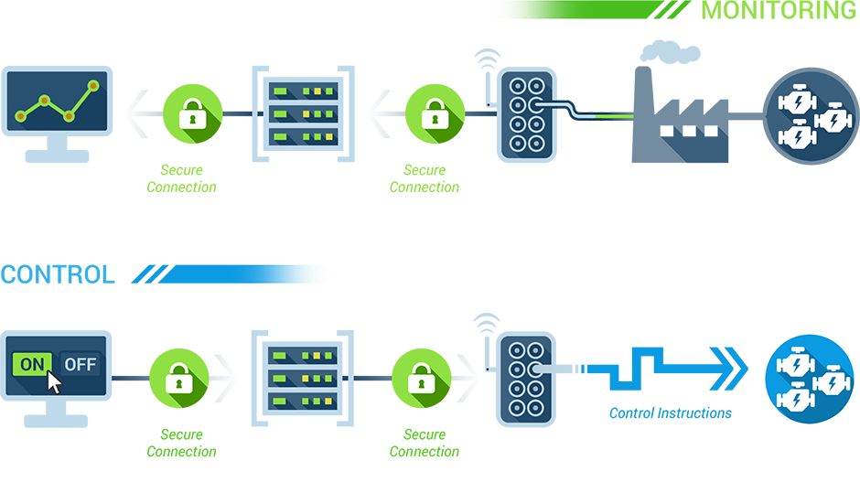

Slide 14
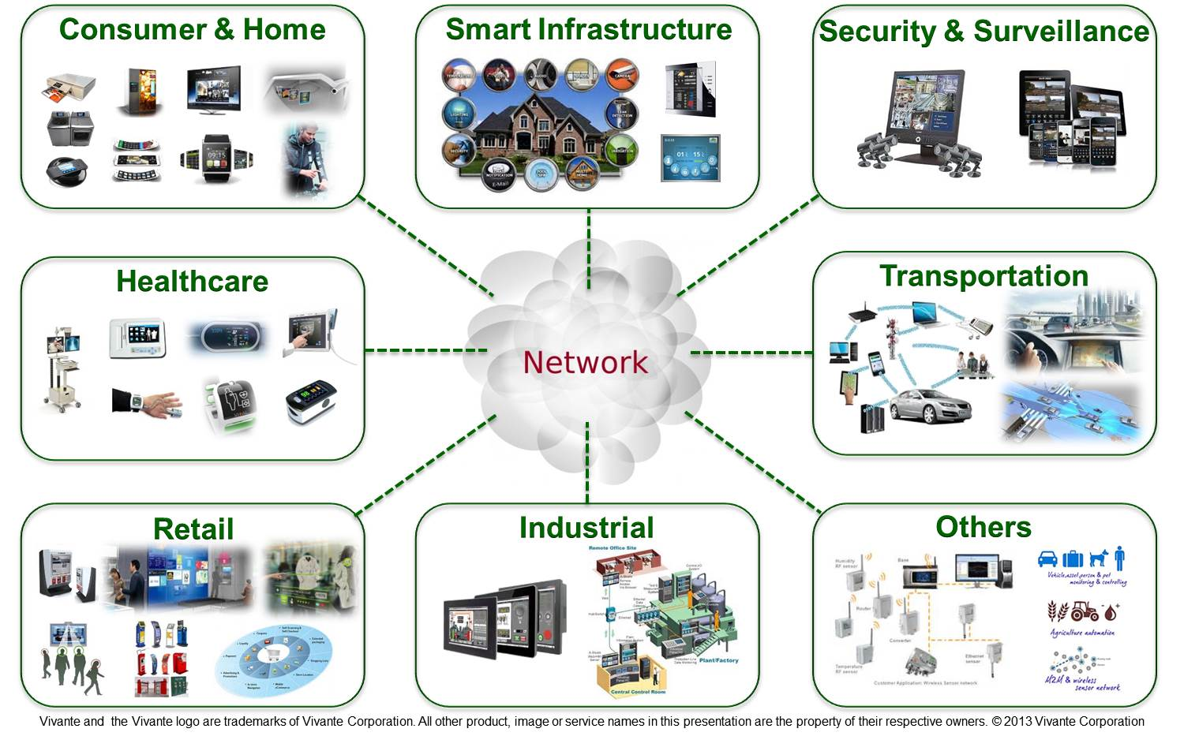
Applications of IOT

Slide 15
The current technology in healthcare and a general practice of medicine gets enhanced with the IoT system.
IoT in transportation enables the asset tracking feature, which keeps track of the physical assets and their information, like location, status, etc.
The Industrial Internet of Things (IIoT) refers to interconnected sensors, instruments, and other devices networked together with computers' industrial applications, including manufacturing and energy management.

Slide 16
Protocols In IOT Application Layer: HTTP/FTP/SMTP….. Transport Layer: TCP/UDP Network Layer : IPv4/IPv6 Link Layer: Ethernet/ WLAN

Slide 17
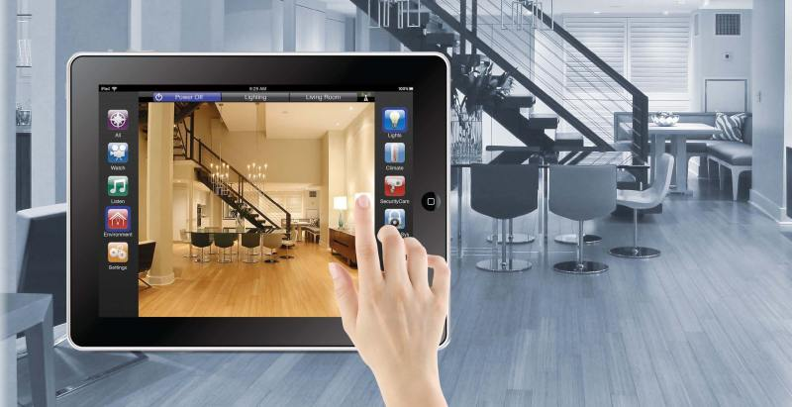
Home Automation Using Raspberry pi
Create a things board account by using http://demo.thingsboard.io/login
Create a dashboard for raspberry pi and add client
Create an access token in device option
Edit code with access token and then run the code

Slide 18
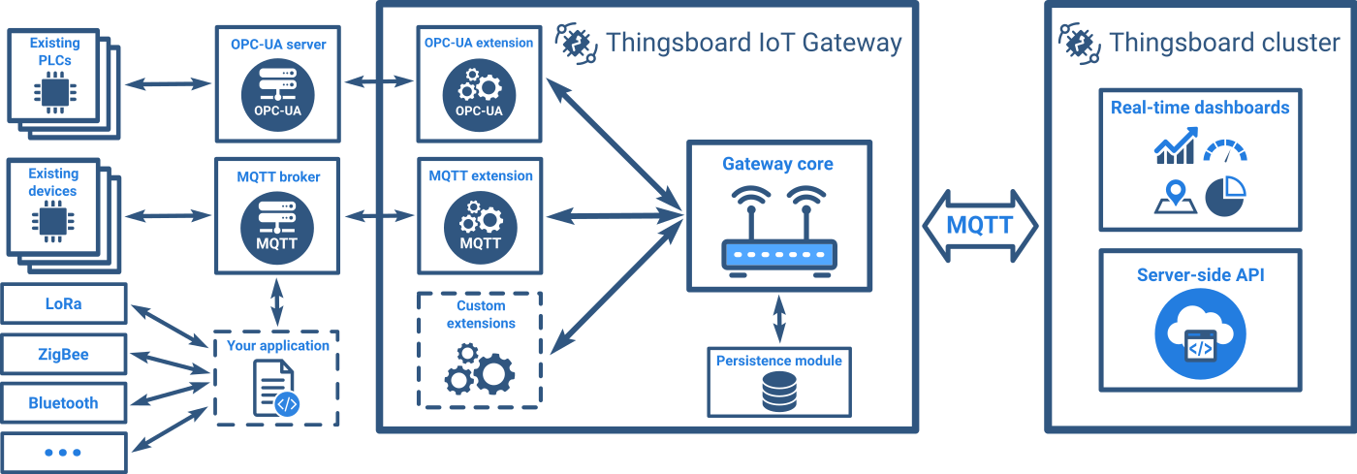
Home Automation Using Raspberry pi

Slide 19
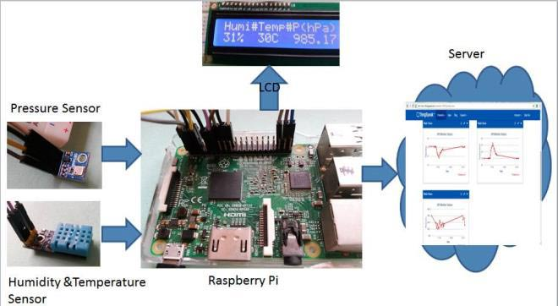
Weather monitoring system
Humidity, Temperature and Pressure are three basic parameters to build any Weather Station and to measure environmental conditions.
We will use DHT11 Humidity & temperature sensor for sensing the temperature and BM180 Pressure sensor module for measuring barometric pressure.
All this data is sent to ThingSpeak server for live monitoring from anywhere in the world over internet.

Slide 20
Block Diagram

Slide 21
Conclusion
We have studied Raspberry Pi and its applications in the field of IOT. Also, learned its components, examples and applications. We have observed that IOT is going to revolutionize the future and as a result we have to be prepared for meeting expected challenges in this field.
Raspberry Pi is a major breakthrough in IOT, as it can perform all operations of a computer, and having compact size, which is affordable. Interacting with the real world is the major benefit of raspberry pi.

Slide 22
Thank you!!!

